Slide 1

Machine Learning Midterm Project
Ozge Usal
October 2022

Slide 2


CONTENT
2
Data Understanding (EGA)
4
Conclusion & Next Steps
Real Estate Industry
1
3
5
Data Definition
Project Steps

Slide 3

Real Estate Industry
The real estate industry has a very important role in the economy. Also, it impacts relevant industries
such as construction, public welfare, and investment significantly.
Because housing is the main need for
people, the real estate market is one of the most competitive market and has various variables to determine house prices.
Because of all these, It could be utilized as one of the prime fields to apply the concepts of machine learning.
Photo by Alexander Andrews on Unsplash

Slide 4

Real Estate Industry Best Practices
Analyzing clients’ needs accurately
Building trust with clients
Being the intermediary for other services
Balancing selling and service

Slide 5

Real Estate Applications
All best practices are considered quick and accurate matches between people and houses are very important
for the real estate industry.
By applying machine learning technics, house prices are estimated. This estimation helps the clients
when choosing their houses. Clients spend less time when choosing a house according to their needs.
Machine learning technics could give effective assessments for predicting house prices. It affects clients’ life quality and real estate industry power.
It increases the work quality of real estate agents.
Photo by Redd on Unsplash

Slide 6

Data Definition
House price of the unit area falls under the category of Quantitative data type
Because it is measurable and has an infinite number of possible values within an interval, It is categorized as continuous data.
The aim of the project is to predict house prices
“Y house of unit area column” used as the target for machine learning processes

Slide 7
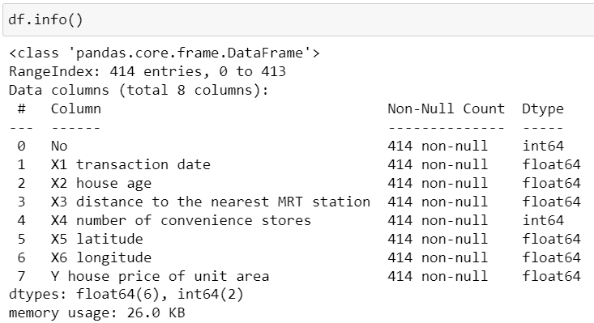
Data Understanding (EDA)
Dataset
Columns
The dataset for this project is the Real Estate.csv dataset from Kaggle Real Estate Price Prediction Dataset
The data set consists of features in numerical data as integer and float
There are 414 rows in the dataset
There are a total of 8 columns/attributes in the dataset
There is no missing data and noise in the dataset
No
X1 transaction date
,X2 house age
X3 distance to the nearest MRT station
X4 number of convenience stores,
X5 latitude,
X6 longitude,
Y house price of unit area

Slide 8
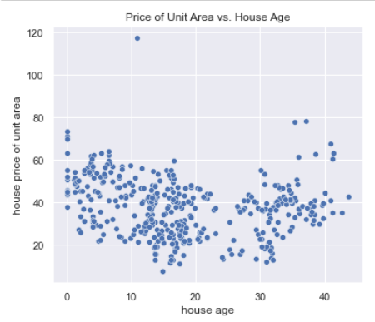
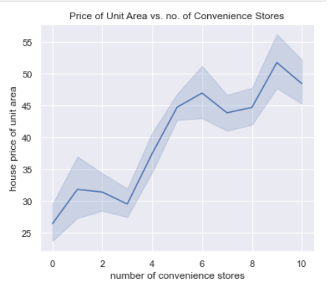
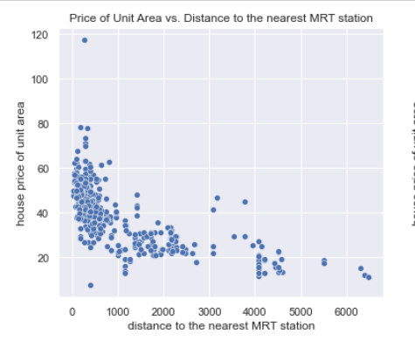
Data Understanding (EDA)
House price of the unit area is proportional to the number of convenience stores
House price of the unit area is inversely proportional to the distance to the nearest MRT station
House age is not proportional to the price of unit area

Slide 9

PROJECT STEPS
DATA UNDERSTANDING (EDA)
Data Types
Data shape and size
Columns and Rows
Correlation between columns
DATA PREPARATION
Split train and test data
Feature Scaling
Polynomial Features
MODELLING
Linear Regression
Polynomial Regression
Regulations( L1, L2 and Elastic)
Evaluating models
CONCLUSION
Residuals
Comparison between models

Slide 10
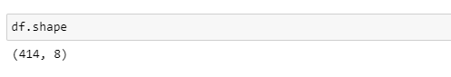
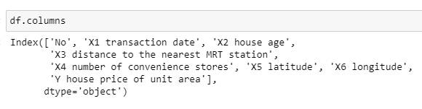
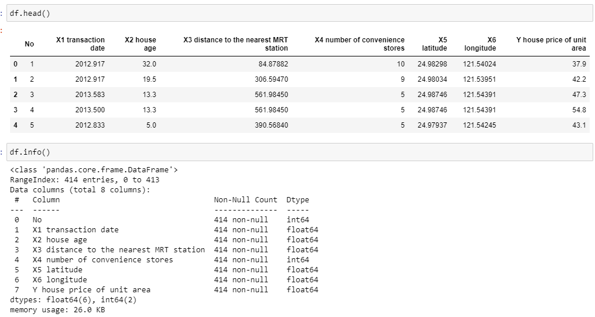
DATA UNDERSTANDING (EDA)
df.shape → to learn size of the data
df.columns → to learn name of columns
df.head() → to preview of the data
df. Info() → to check null values and data types
sns.heatmap(df.corr(), annot=True,cmap='YlGnBu’) →
to visualize the correlation between columns as a heatmap
Histograms → to visualize the density of columns as histograms

Slide 11
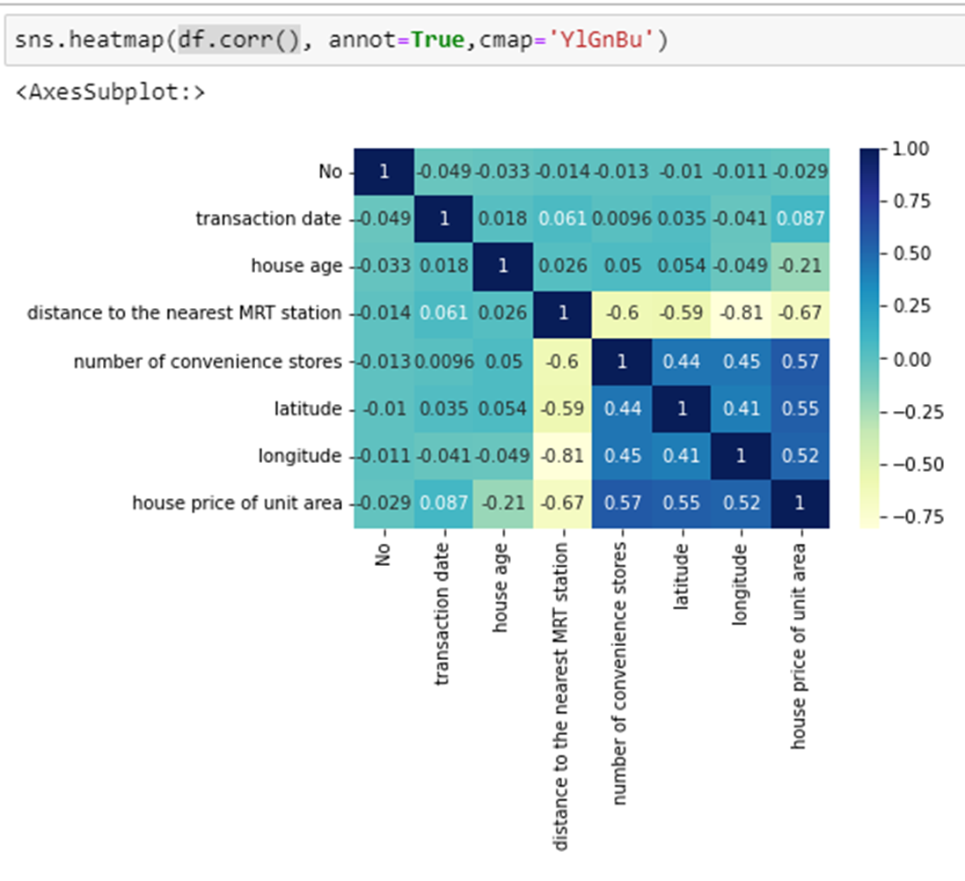
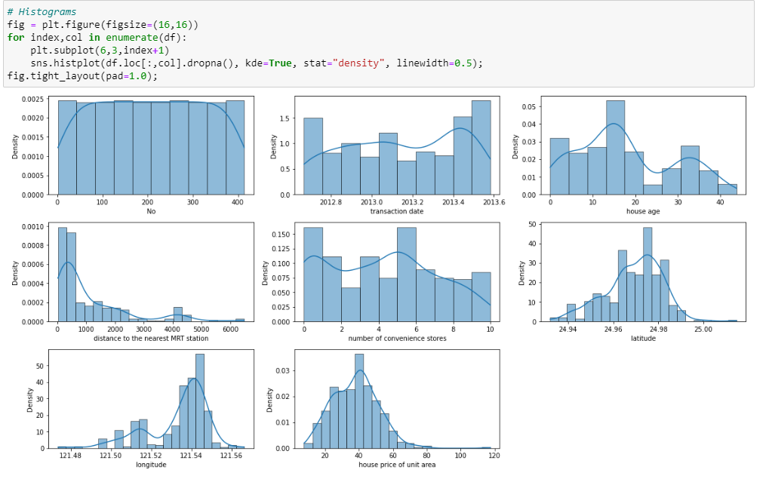
DATA UNDERSTANDING (EDA)

Slide 12
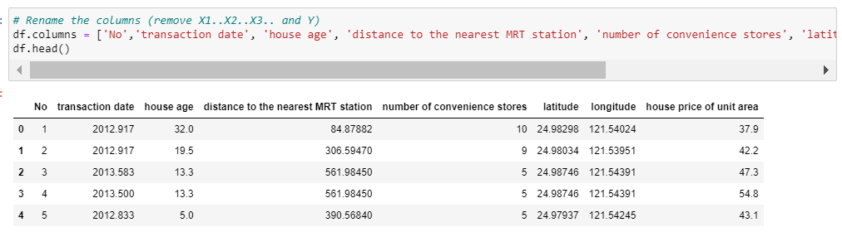
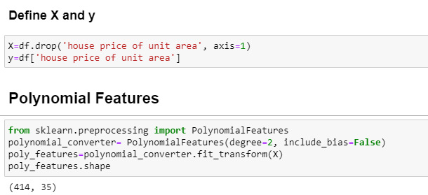
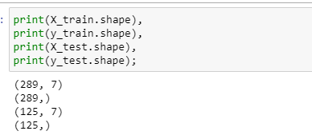
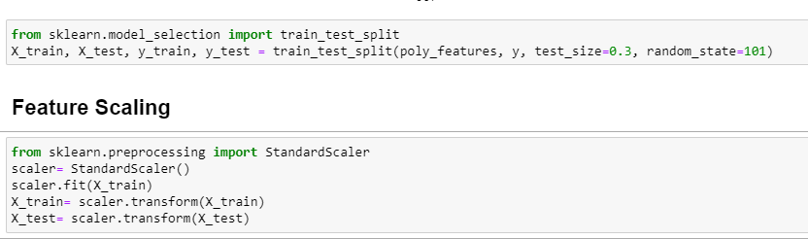
DATA PREPARATION
df.columns = […] → to rename colums
X=df.drop('house price of unit area', axis=1) → to define X parameter
y=df['house price of unit area']→ to define y parameter
polynomial_converter= PolynomialFeatures(degree=2, include_bias=False)
poly_features=polynomial_converter.fit_transform(X)→ perform a polynomial features transform of the dataset
train_test_split( X, y, test_size=0.3, random_state=101)→
split data as test and train (30% test, 70% train)
StandardScaler() → to make all coefficients in same scale. features are rescaled to standard distribution with Mean=0,std=1.

Slide 13
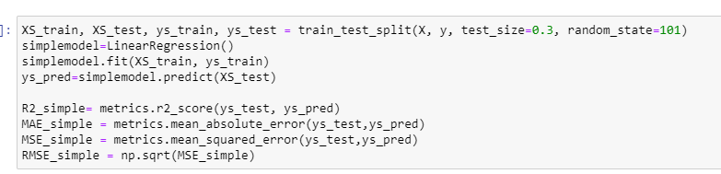
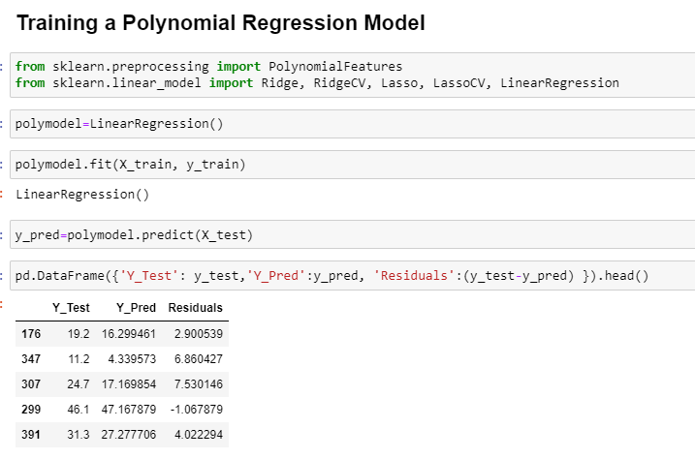
MODELLING
simplemodel.fit(XS_train, ys_train)
ys_pred=simplemodel.predict(XS_test)→ for applying Linear Regression model
metrics→ to calculate model metrics( R2 core, mean absolute error, mean square error, root mean square error)

Slide 14
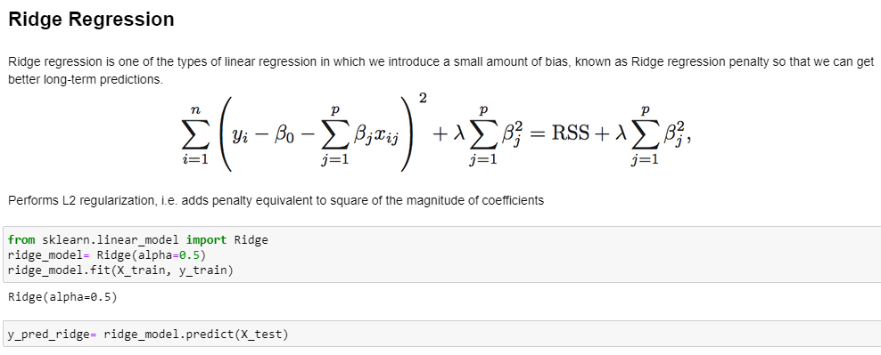
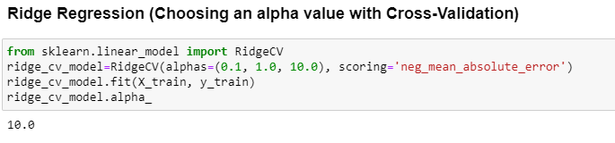
MODELLING
ridge_model= Ridge(alpha=0.5)→ for applying Ridge Regression model
ridge_cv_model=RidgeCV(alphas=(0.1, 1.0, 10.0), scoring='neg_mean_absolute_error')→ In order to decreasing of data leakage, Cross validation methode would be helpful. (dividing data to K fold and iterate the train_test method more and more to find best result)

Slide 15
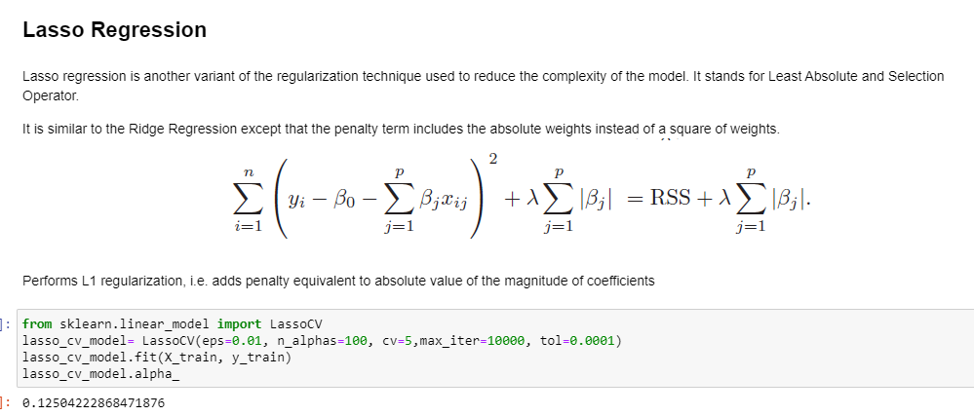
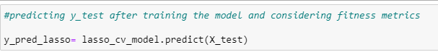
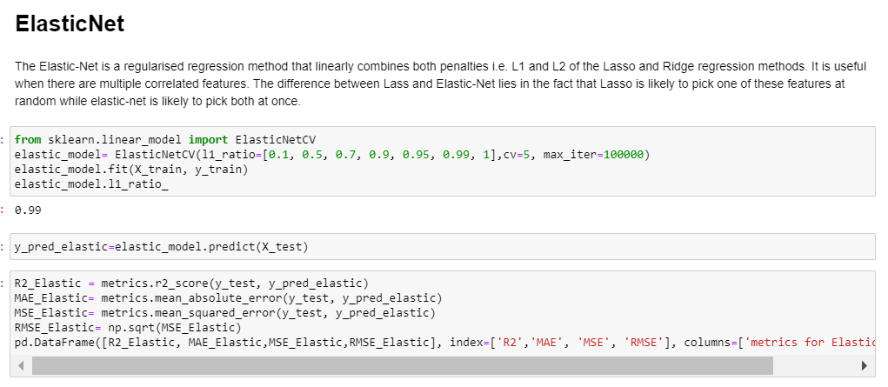
MODELLING
lasso_cv_model= LassoCV(eps=0.01, n_alphas=100, cv=5,max_iter=10000, tol=0.0001) …→ for applying Lasso Regression model
elastic_model= ElasticNetCV(l1_ratio=[0.1, 0.5, 0.7, 0.9, 0.95, 0.99, 1],cv=5, max_iter=100000)… → for applying ElasticNet model

Slide 16
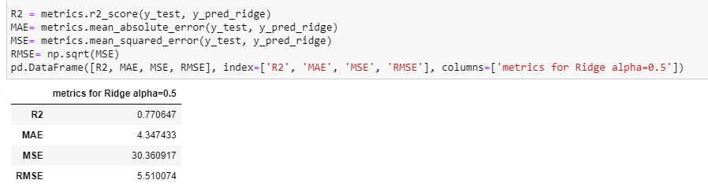
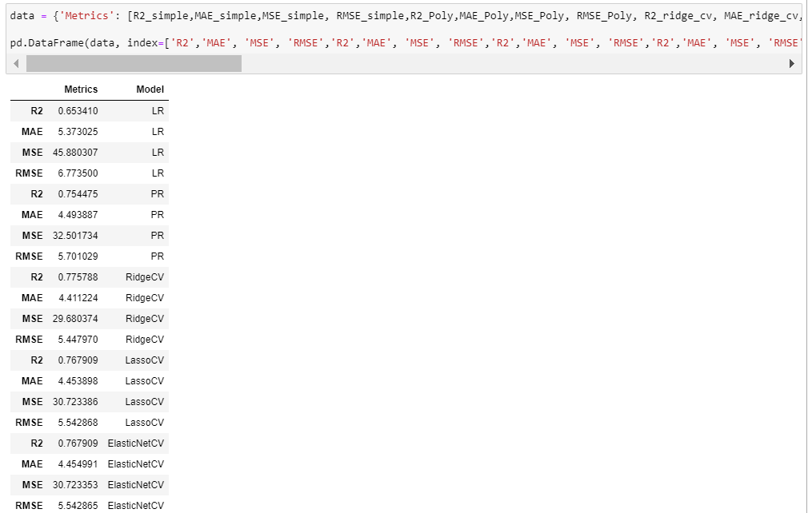
MODELLING
For all models, R2 score, mean absolute errors, Mean squared errors, and root mean squared errors are calculated using sklearn. metrics
A dataframe are creaed for comparasion

Slide 17
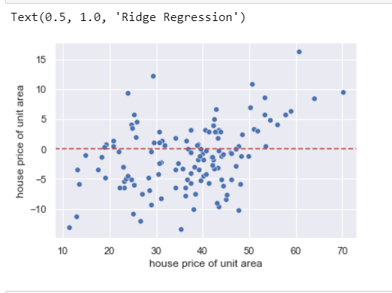
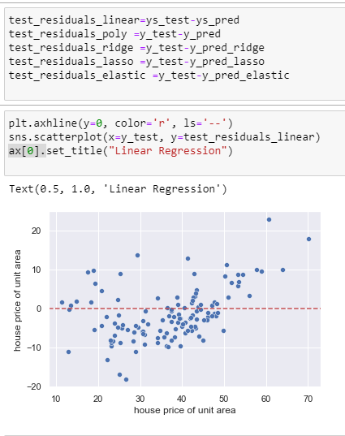
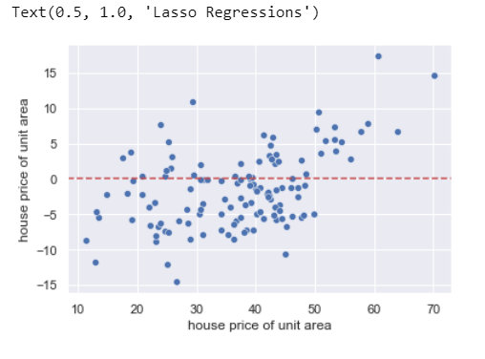
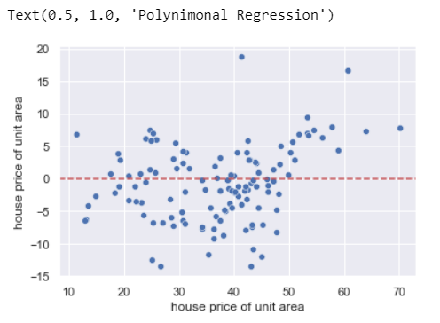
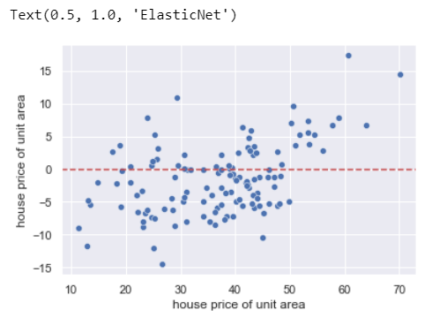
CONCLUSION
A residual value is a measure of how much a regression line vertically misses a data point. Regression lines are the best fit of a set of data.
Residual Values on the vertical axis; the horizontal axis displays the independent variable.
When the R2 scores and RMSE values are compared,
Ridge method has minimum RMSE and maximum R2 score

Slide 18
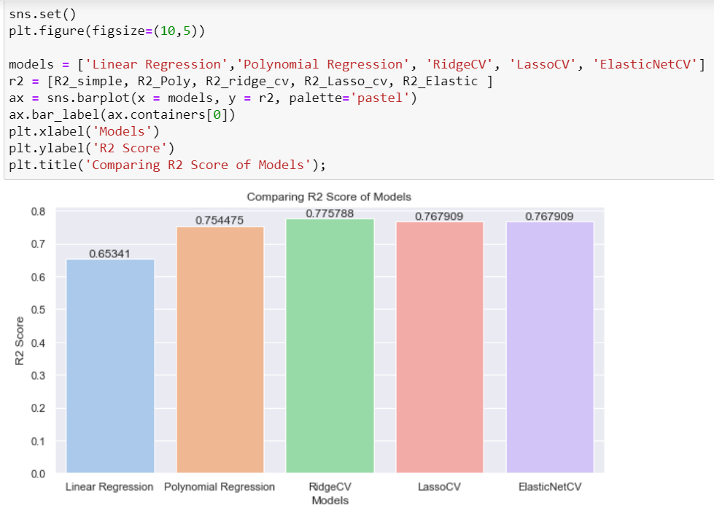
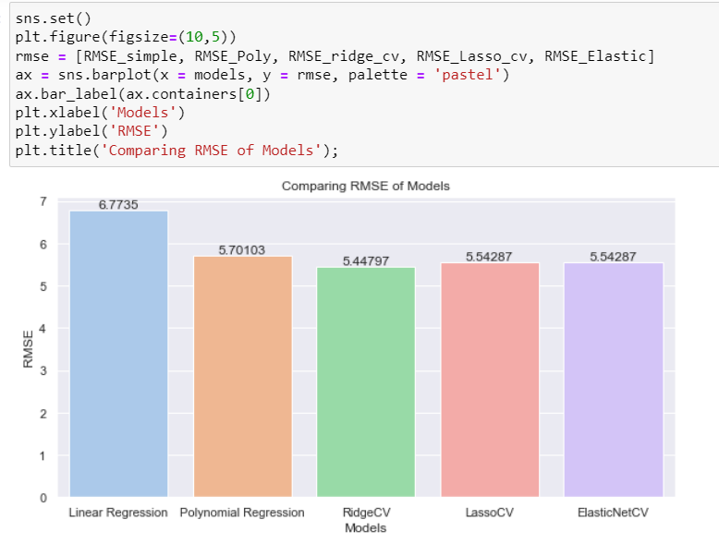
CONCLUSION

Slide 19

NEXT STEPS
Other machine learning algorithms can be applied to reduce RMS error.
Noncorrelated columns can be removed in the data processing step and can be made comparisons between accuracies.
Outliers for columns can be detected and removed from data that test the accuracy changes in the model.

Slide 20
Thank you!

Slide 21
Resource
Page
https://www.upgrad.com/blog/types-of-data/
https://towardsdatascience.com/regression-modeling-in-predicting-optimal-house-sales-price-in-ames-iowa-d5e63f6d44e2
http://cs229.stanford.edu/proj2016/report/WuYu_HousingPrice_report.pdf
https://www.intellspot.com/discrete-vs-continuous-data/
https://seaborn.pydata.org/
https://www.itl.nist.gov/div898/handbook/eda/section1/eda11.htm
https://machinelearningmastery.com/polynomial-features-transforms-for-machine-learning/
https://www.kdnuggets.com/2019/03/beginners-guide-linear-regression-python-scikit-learn.html
https://towardsdatascience.com/simple-and-multiple-linear-regression-in-python-c928425168f9
https://www.tutorialspoint.com/scikit_learn/scikit_learn_elastic_net.htm
https://towardsdatascience.com/preprocessing-with-sklearn-a-complete-and-comprehensive-guide-670cb98fcfb9
https://www.analyticsvidhya.com/blog/2021/07/all-you-need-to-know-about-polynomial-regression/#:~:text=Polynomial%20regression%20is%20a%20form,convert%20it%20into%20Polynomial%20regression.

